Slide 1

YELP DATA ANALYTICS
What can YELP Data Analysts do for you?

Slide 2

Our Team EMJB Analytics
ElieHakim
Miguel Patxot
Jon Rinko
Ben Suh
Bringing data to life since 2019

Slide 3

Our client is looking to expand their restaurant empire to California, Texas, Chicago or New York
Project Goals:
Determine which geographic area provides the best business opportunity
Determine which categories of food groups to include on their menu
Determine which areas have the most competition
Notes:
This slide looks like crap – fix later

Slide 4
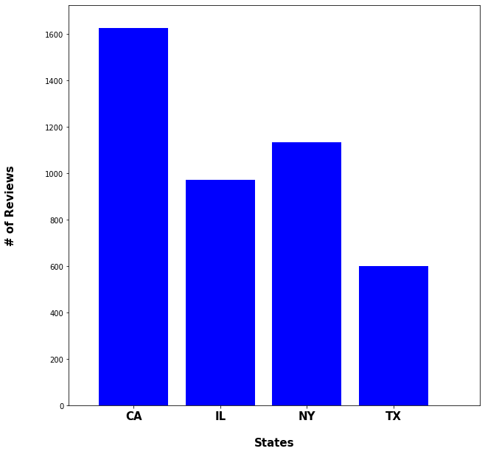
Average Reviews per Restaurant by State
Notes:
This data shows which states receive the most reviews or customers using yelp and reviewing their restaurant.
Assuming the overhead and upkeep for the restaurant is the same in each state, CA looks promising so far.

Slide 5
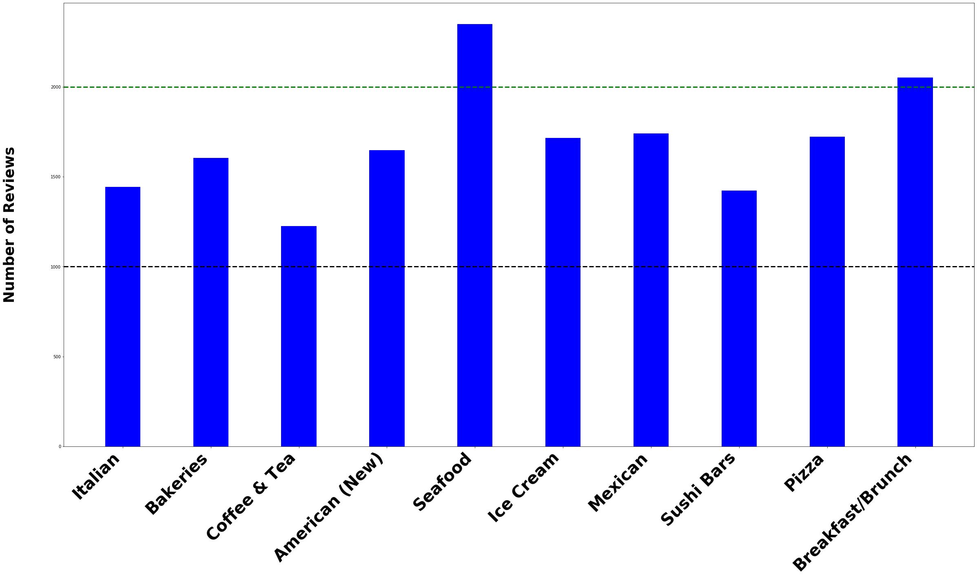
Top 10 Categories in San Francisco
Notes:
This data shows top 10 categories in CA.
Check csv for counts and add labels to top 3.

Slide 6
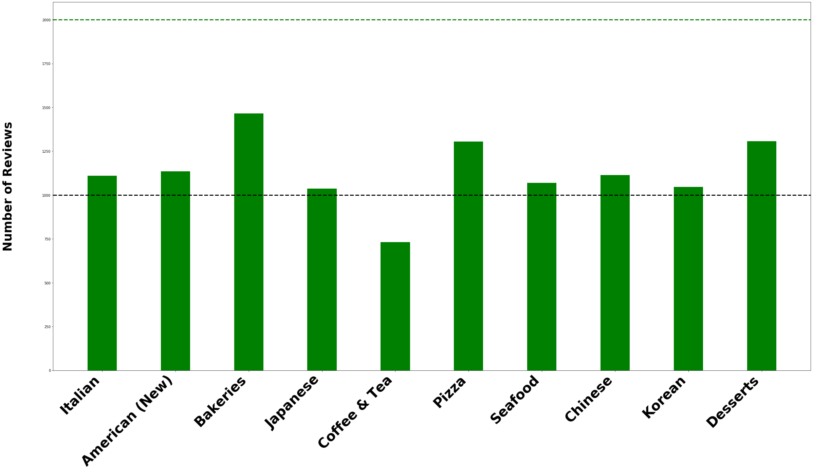
Top 10 Categories in New York City
Notes:
This data shows top 10 categories in NY

Slide 7
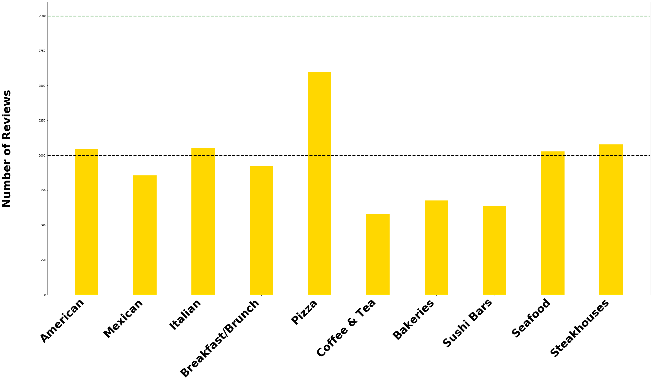
Top Ten Categories in Chicago, IL
Notes:
This data shows top 10 categories in CA.

Slide 8
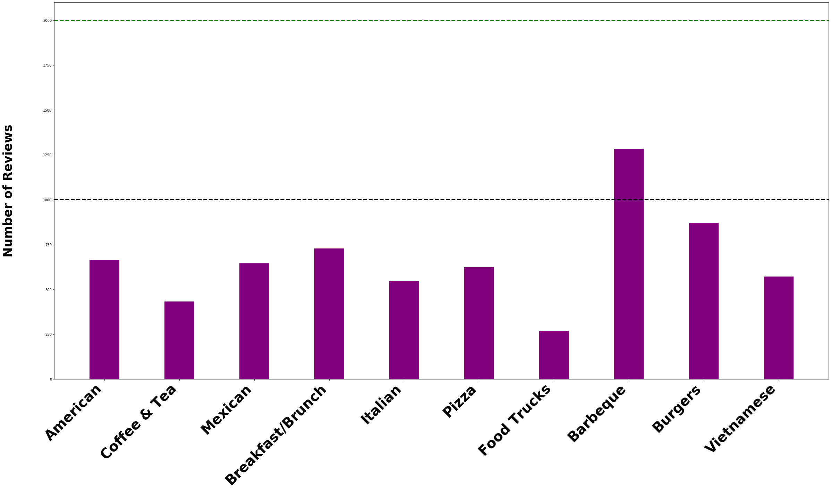
Top 10 Categories in Texas
Notes:
Clearly BBQ is #1 in Texas. American is actually a combination of New American and Traditional, but was combined during cleaning of the data. New American is often described as having more fusion.

Slide 9
Lessons learned from analysis:
The most reviews come from CA and then NY as these are some of the busiest cities in the country
Many of the most popular categories are similar regardless of location: Italian, American(New and Traditional), Breakfast, Mexican, Seafood, …
One thing that stands out from the analysis: TX is famous for BBQ and burgers and that is a significant data point
Based on the analysis, it appears CA has the most demand for a new restaurant and some of the most popular restaurants in CA are involve seafood and American fusion.

Slide 10
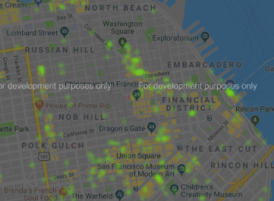
San Francisco Heat Map By Rating
Where is our competition?
Will we be able to stand the heat?
Notes:
Using heatmaps of ratings with Google Maps we can take a closer look at our competition. We can see that the financial district is a popular location as well as Union Square.

Slide 11

Data Collection Points
North
Illinois
South
Texas
East
New York
West
California
Notes:
We used the yelp API to sample NY, CA, TX, IL
We were able sample over 2500 businesses, & reviewed the ratings, price points, and categories.
We spent significant time cleaning the data, removing outliers that did not fit our search params.

Slide 12
Explaining the Data
How we got the data
Notes:
Talk through

Slide 13


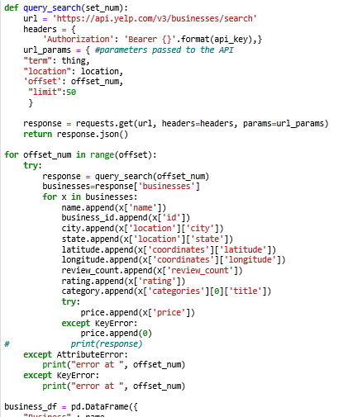
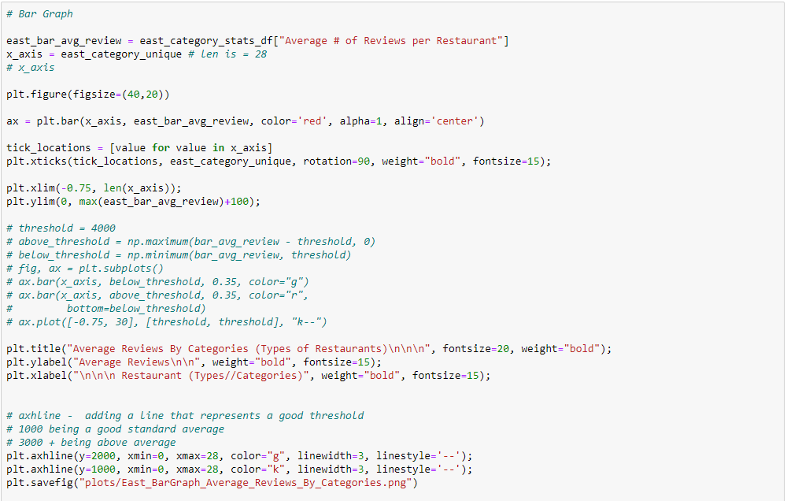
Show the code
Search Technique
Graphing techniques

Slide 14

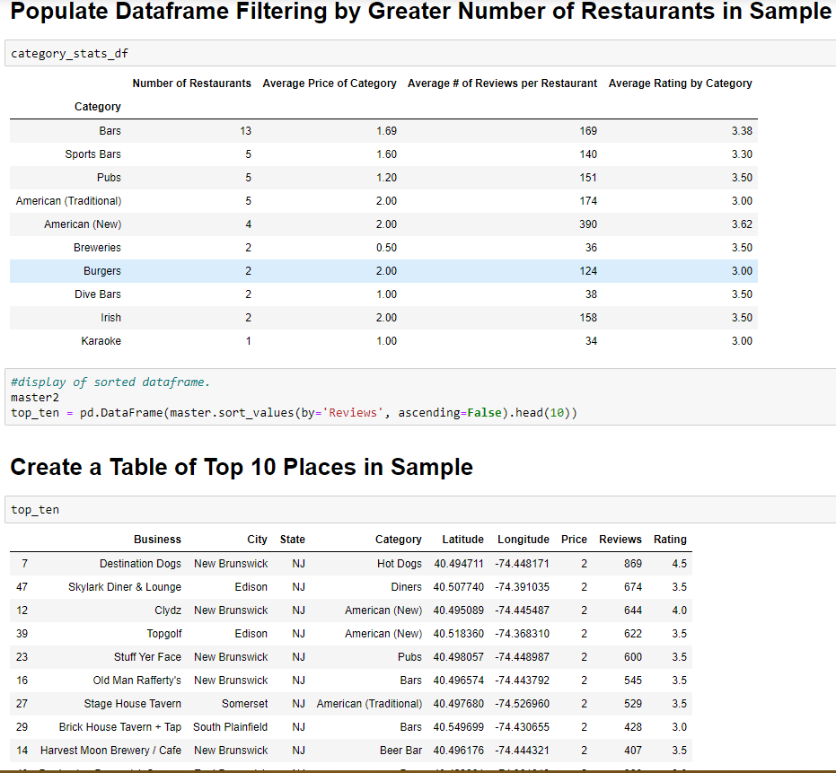
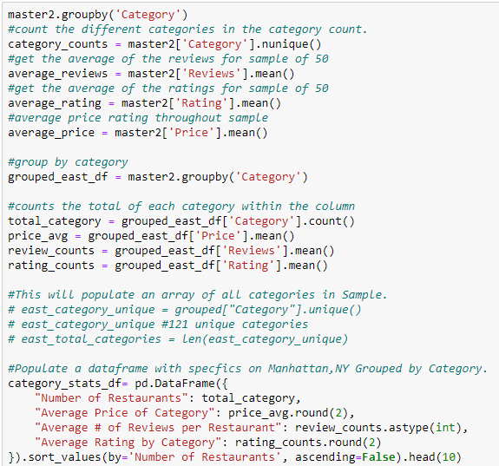
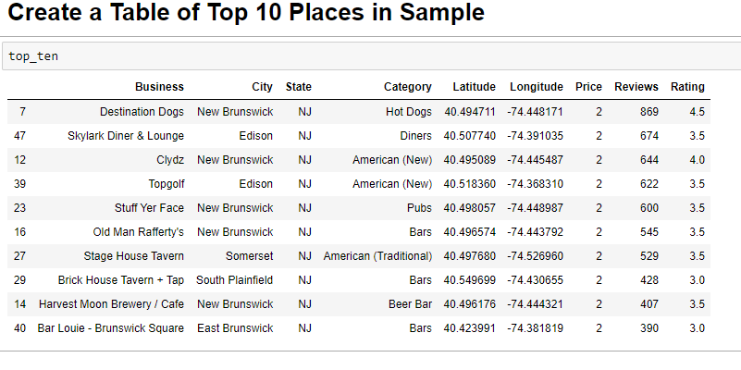
Show the code
Filter/Cleaning Techniques
Notes:
Showcase the code that executes the tasks

Slide 15
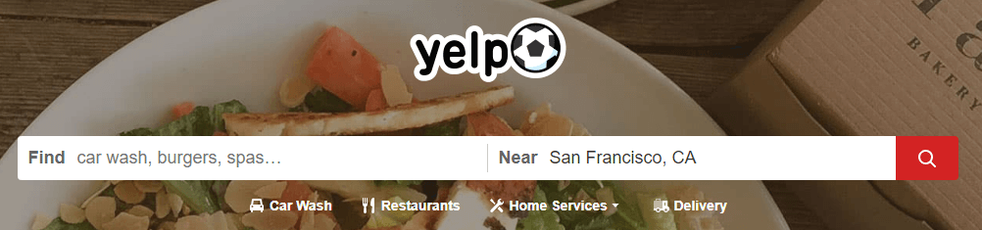
Demonstration
Notes:
Questions?

Slide 16
BEST BURGER SPOT
SUBTITLE HERE
YOUR HEADING | YOUR HEADING | YOUR HEADING | YOUR HEADING
Place content here | Place content here | Place content here | Place content here
Place content here | Place content here | Place content here | Place content here
Place content here | Place content here | Place content here | Place content here
Place content here | Place content here | Place content here | Place content here
Place content here | Place content here | Place content here | Place content here
Place content here | Place content here | Place content here | Place content here
Place content here | Place content here | Place content here | Place content here
Place content here | Place content here | Place content here | Place content here

Slide 17


THANK YOU

Slide 18
Questions?
Notes:
Questions?

